Slide 1
Arduino Lab 5 : Accelerometer and Wireless Communication
Asst. Prof. Dr.Sumek Wisayataksin
Faculty of Engineering
King Mongkut’s Institute of Technology Ladkrabang

Slide 2
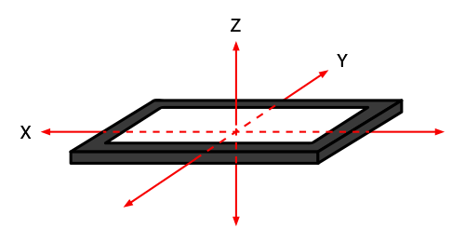
Accelerometer
Use to find the tilt angle of the object (3-Axis Accelerometer)

Slide 3
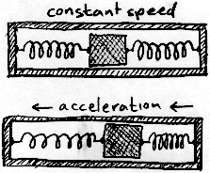
How it work ?
Gravity
ᶿ
G*sin(θ)

Slide 4

How it work ?

Slide 5
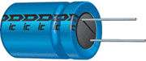
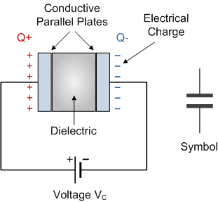
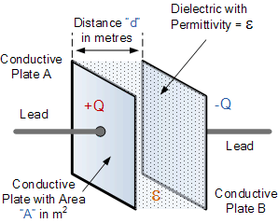
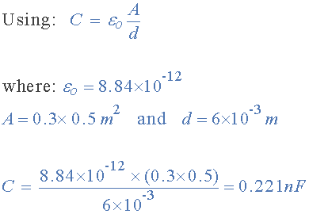
Capacitor / Capacitance

Slide 6
3-Axis Accelerometer
Z
X
Y

Slide 7
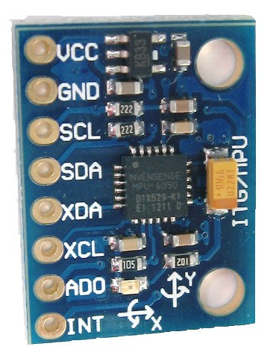
MPU6050
5V
GND
SCL
SDA

Slide 8
Inter-Integrated Circuit (I2C)
I2C communication uses only 2 signals (SCLK and SDA)
-SCL : Clock of the system sending from Master to Slave.
-SDA : Bidirectional Data (It can send and receive data in the same line).
Master Node is a device that send clock to slaves. (Arduino)
Slave Node is a device that receive command from the master. (Sensor)
MASTER
SLAVE
SCL
SCL
Arduino
Sensor
SDA
SDA

Slide 9
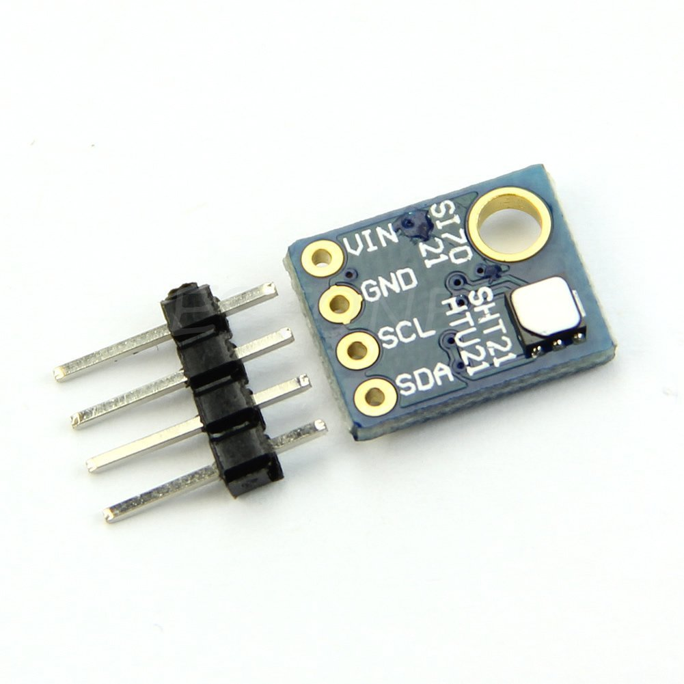
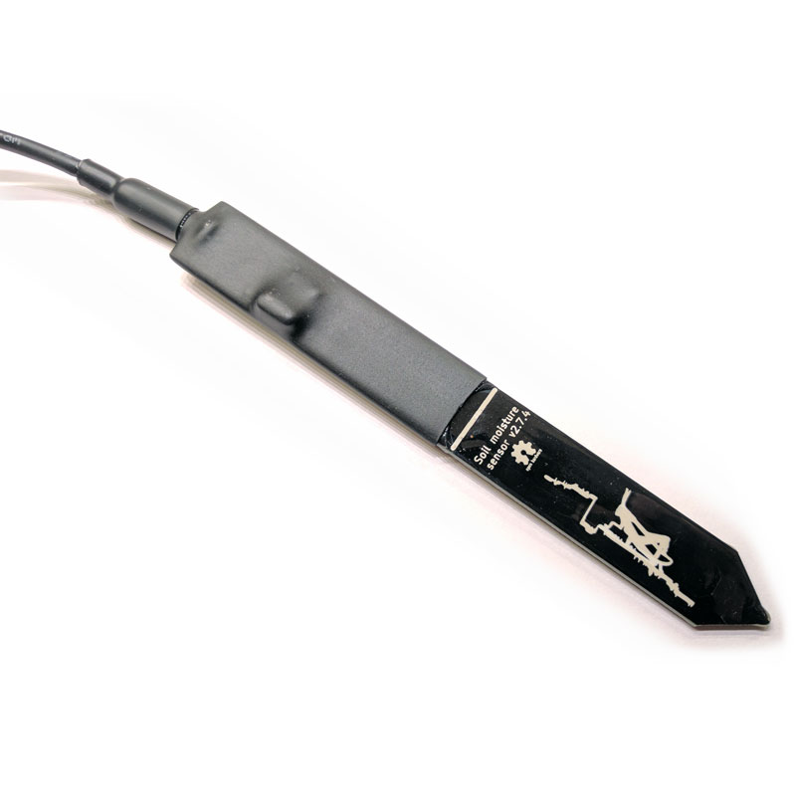
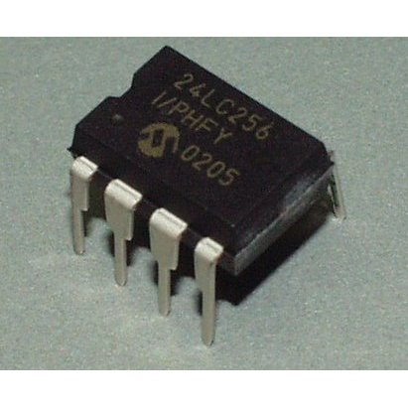
Sensors with I2C interface
High Precision Humidity Sensor
Soil Moisture Sensor
I2C EEPROM

Slide 10
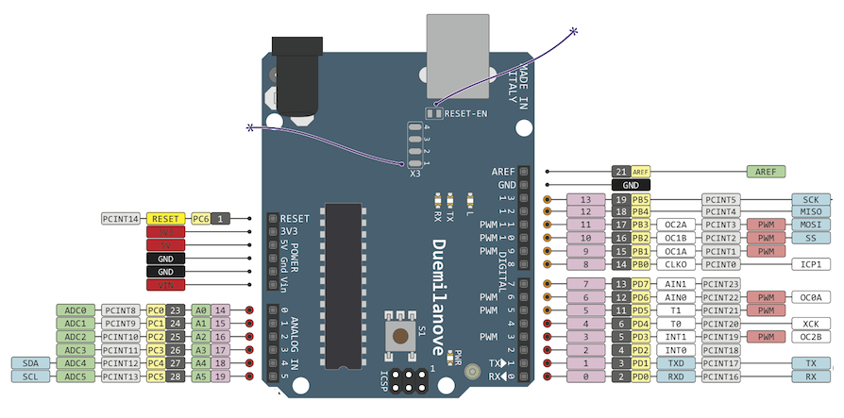
I2C interface in Arduino
SDA
SCL

Slide 11
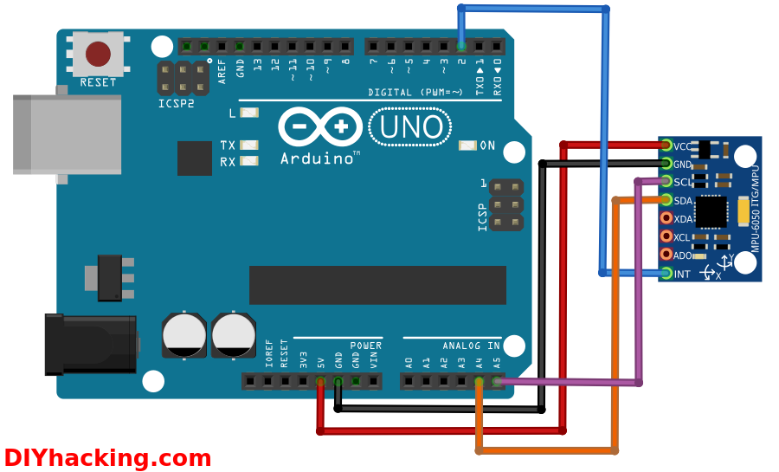
Lab 5.1 : Accelerometer

Slide 12
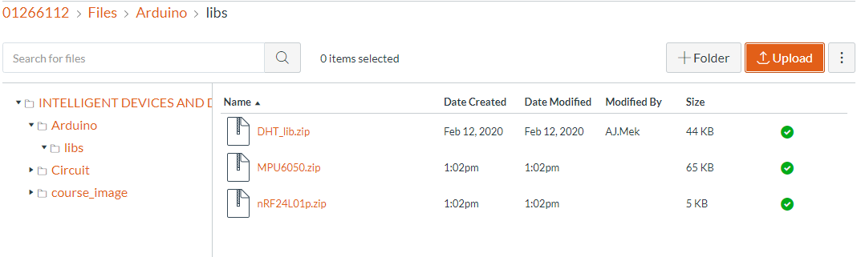
Lab 5.1 : Accelerometer
Download and install 2 libraries
2 libraries

Slide 13
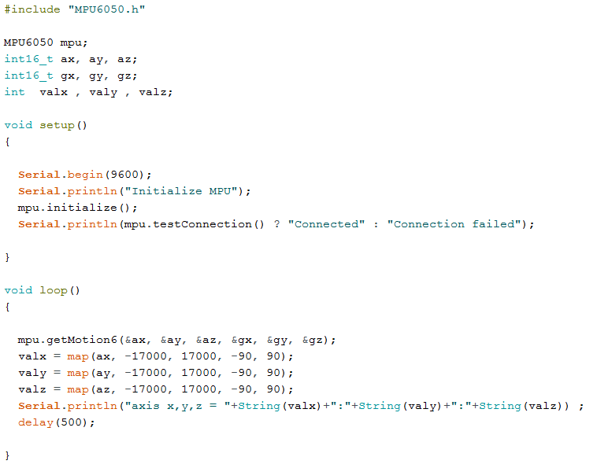
Lab 5.1 : Accelerometer

Slide 14
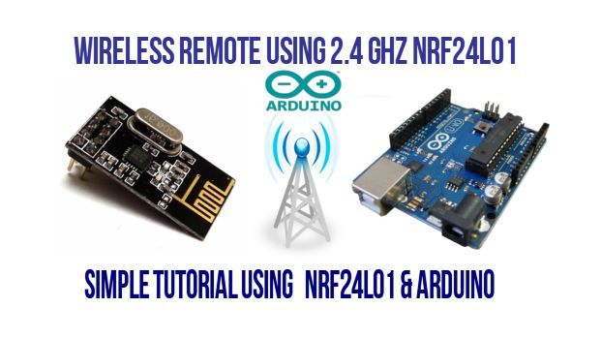
Wireless Communication Module
Data rate 250 kbps up to 2 Mbps.

Slide 15
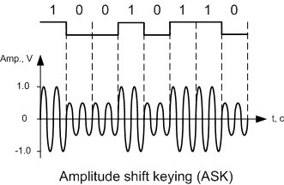
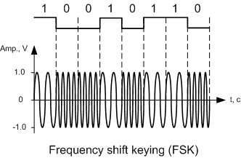
Data Modulation
A sin(w₁t)
A sin(w₂t)
A₁sin(wt)
A₂sin(wt)
AM
FM

Slide 16
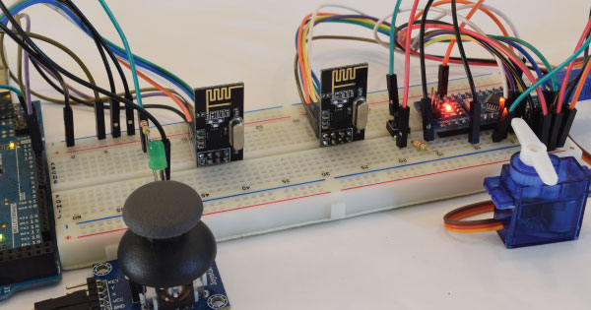
Wireless Communication Module

Slide 17
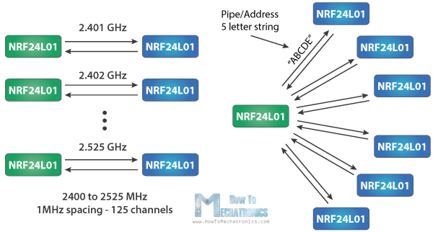
Wireless Communication Module
Address
Channel

Slide 18
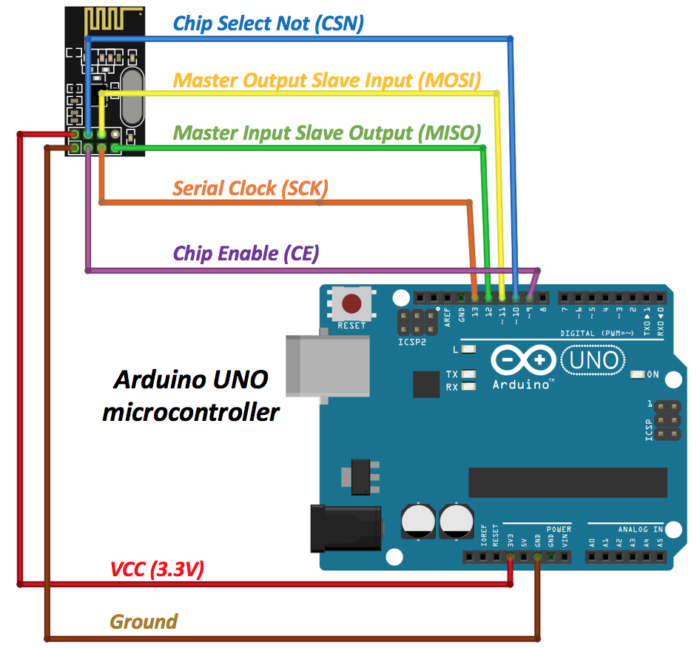
Arduino Wireless Communication
Arduino1
Arduino2
Send Message

Slide 19
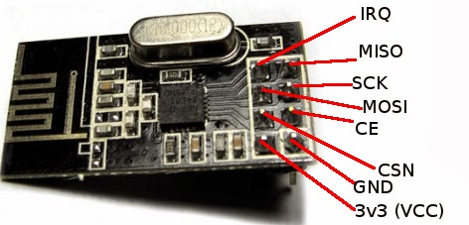
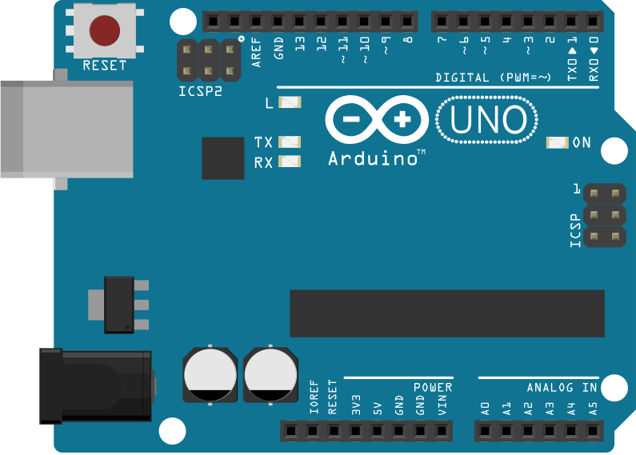
NRF24L01 Wireless Communication Module
VCC -> 3v3
GND -> GND
CSN -> Digital 7
CE/SS -> Digital 8
MOSI -> Digital 11
SCK -> Digital 13
MISO -> Digital 12

Slide 20
Serial Peripheral Interface (SPI)
Serial Peripheral Interface has 4 signals
- SCLK : System clock from master to slave.
- MOSI : Master Out Slave In (Data out from Arduino)
- MISO : Master In Slave Out (Data into Arduino)
- CE : Chip Select to select slave.
MASTER
SLAVE
D7
D6
D5
D4
D3
D2
D1
D0
SCLK
SCLK
MOSI
MOSI
MISO
MISO
0
1
1
0
1
0
0
1
CE
CE

Slide 21
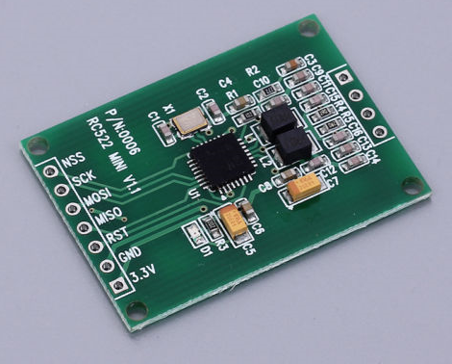
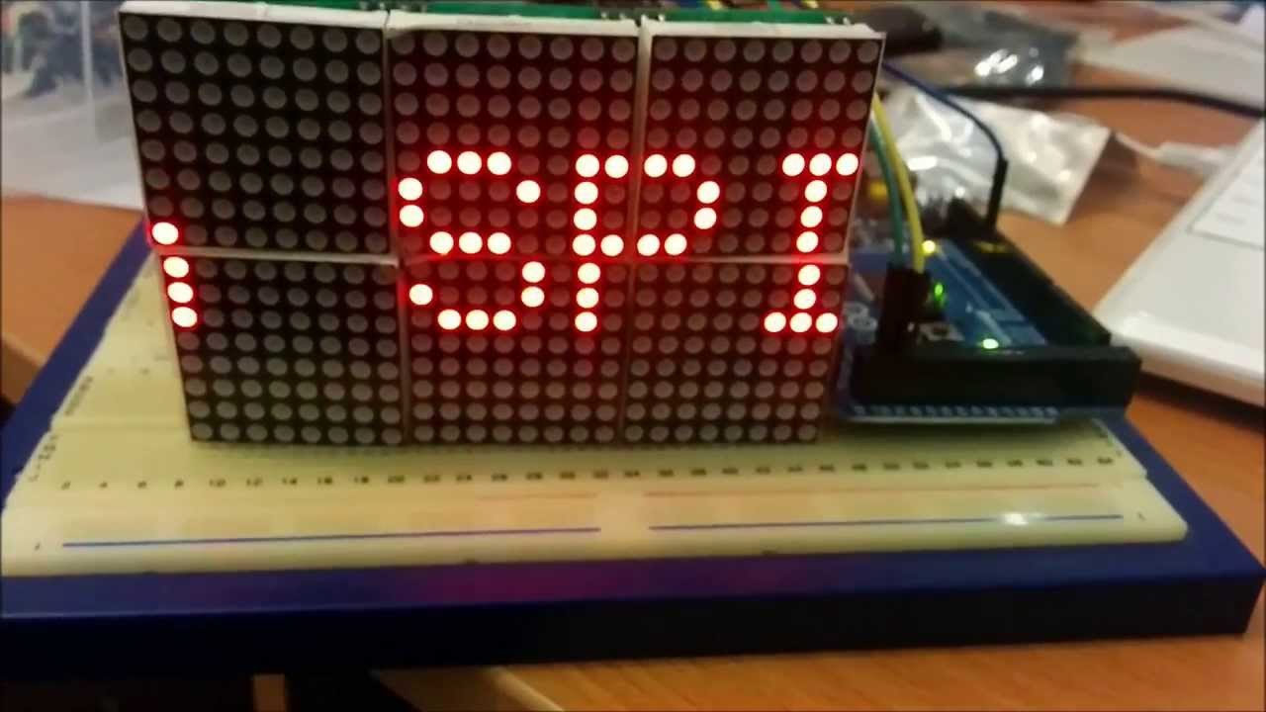
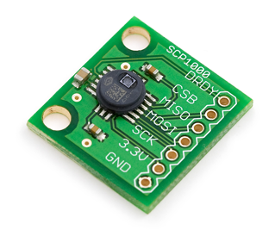
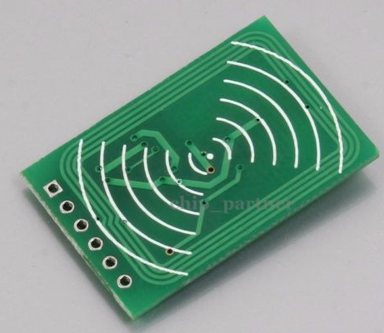
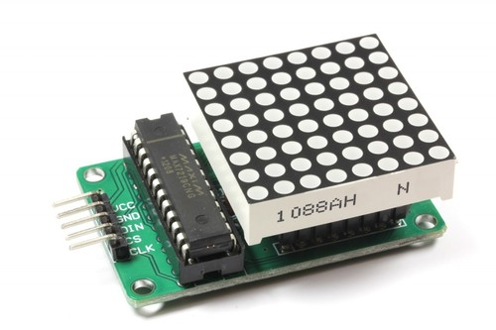
Sensors with SPI interface
RFID Reader
LED Matrix
Pressure Sensor

Slide 22
I2C interface in Arduino
SCK/SCLK = 13
MISO = 12
MOSI = 11
CE = Can be selected

Slide 23
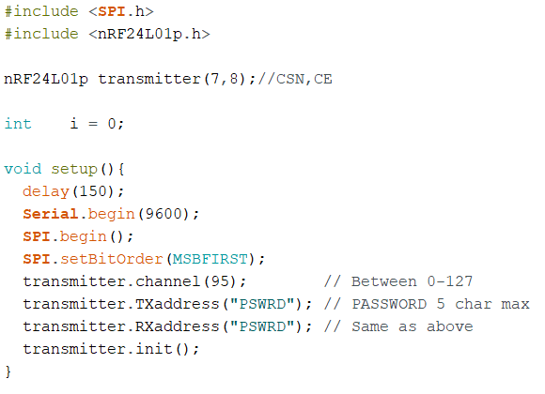
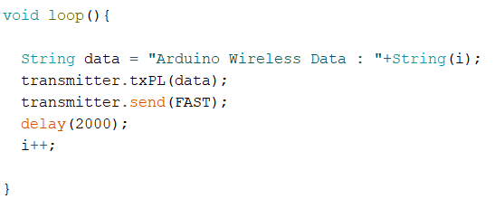
Arduino1 (Transmitter) Sample Code

Slide 24
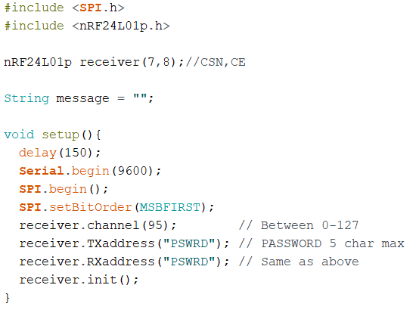
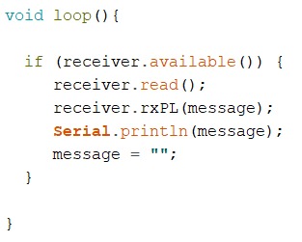
Arduino2 (Receiver) Sample Code
- When both sides are completed, run receiver first, then run transmitter.
- You should see message on receiver side in serial monitor.
Notes:
Only initialize one object (can replace “receiver” with any name)

Slide 25
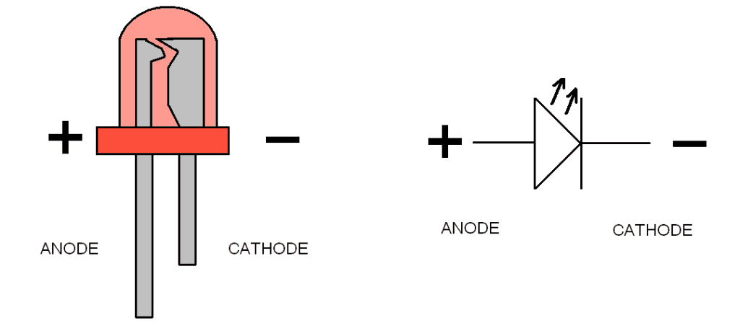
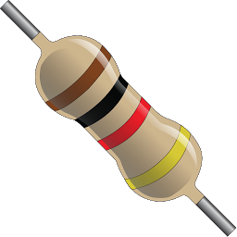
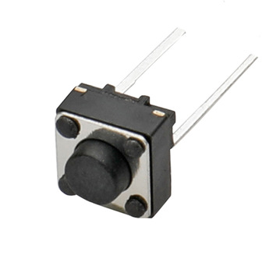
Lab 5.2 : LED wireless control from Light Sensor
Arduino
5v
220
10Kohm
VCC -> 3v3
GND -> GND
CSN -> Digital 7
CE -> Digital 8
MOSI -> Digital 11
SCK -> Digital 13
MISO -> Digital 12

Slide 26
Lab 5.2 : LED wireless control
Requirements
- When button pressed, send message to another side.
- 1st press : Send ON
- 2nd press : Send OFF
- 3rd press : Send ON and so on
- Button event must be the interrupted callback function.
- LED on another side on/off according to the message received.

